Slide 1

Project Title - Sales Forecasting and Data Analysis with Power BI
GLA University
ACHHUTA NAND JHA

Slide 2

PROBLEM STATEMENT
To enhance the supermarket’s business performance by leveraging data analysis techniques, with a focus on time series analysis, to provide valuable insights and accurate sales forecasting.

Slide 3
Project Description The objective is to support the supermarket's strategic decision-making by utilizing Power BI for comprehensive data analysis and sales forecasting. This project involves creating an intuitive and interactive dashboard, providing deep insights into sales data, and forecasting future sales to help the business optimize its strategies for growth, efficiency, and customer satisfaction.

Slide 4
Detailed Components:
Dashboard Creation:
Identify Key Performance Indicators (KPIs)
Design an intuitive and visually appealing dashboard
Add interactive visualizations and filtering capabilities
Data Analysis:
Visualize and chart sales data to evaluate the effectiveness of sales strategies
Provide valuable insights through detailed analysis
Sales Forecasting:
Use historical data for time series analysis
Generate sales forecasts for the next 15 days
Actionable Insights and Recommendations:
Share insights and actionable information
Support the supermarket's goals for growth,
efficiency, and customer satisfaction

Slide 5

WHO ARE THE END USERS?
End Users:
Supermarket Management: To make informed strategic decisions.
Sales Team: To understand sales trends and improve strategies.
Marketing Team: To plan and execute effective marketing campaigns.
Operational Team: To optimize inventory and supply chain management.

Slide 6

Technology Used
Technology Used:
Power BI: For data visualization, dashboard creation, and reporting.
Time Series Analysis: To analyze historical sales data and forecast future sales.

Slide 7
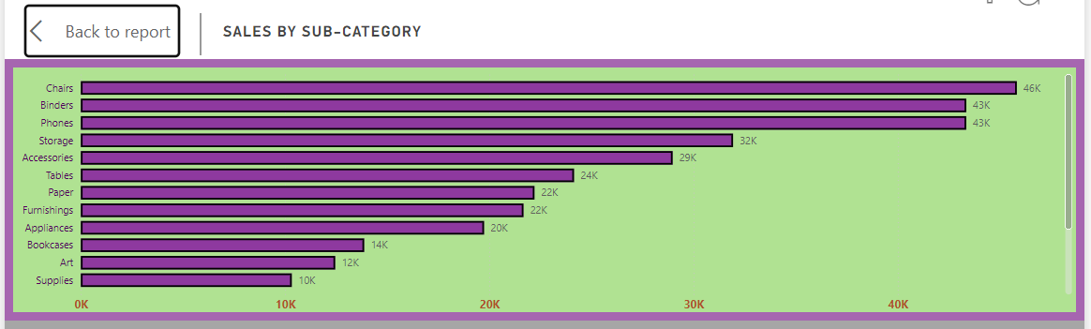
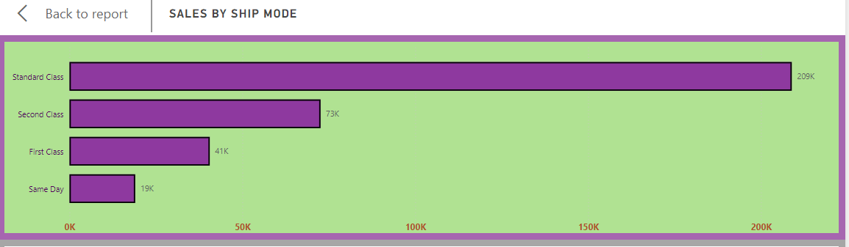
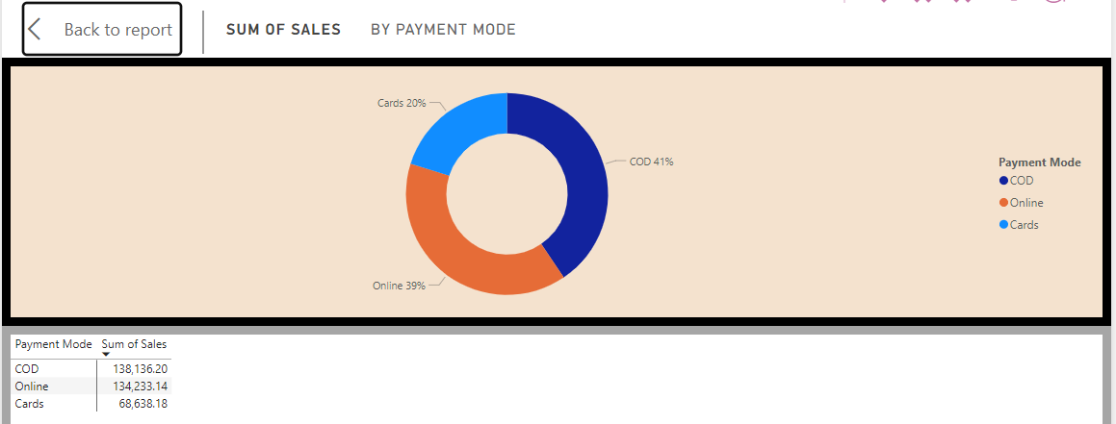
RESULTS
Demo Link

Slide 8
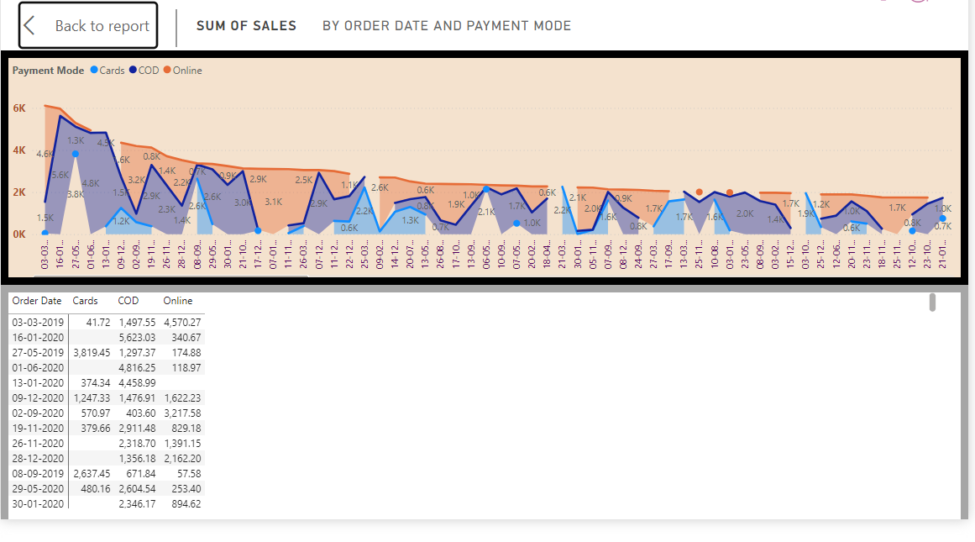
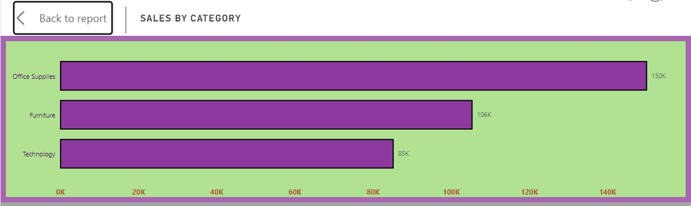

Slide 9
Results:
Interactive Dashboard: An intuitive dashboard with KPIs and interactive visualizations that allow users to explore data at various levels of granularity.
Data Insights: Valuable insights into sales performance and strategy effectiveness, visualized through charts and reports.
Sales Forecasts: Accurate sales forecasts for the next 15 days, helping the supermarket prepare for future demand.
Actionable Recommendations: Strategic recommendations based on data analysis to drive business growth, efficiency, and customer satisfaction.

Slide 10
Conclusion
This Power BI project showcases the importance of data analysis and visualization in making informed business decisions. By leveraging time series analysis and interactive dashboards, the supermarket can enhance its sales strategies, optimize operations, and ultimately achieve its growth and customer satisfaction goals.

Slide 11

Thank you for your attention
.
.

